Slide 1


Welcome to Rhine Class
2026-2027
Year 5 and 6

Slide 2
Rhine Team
Class teachers: Mrs Matthews & Ms Hyde
(Mrs Matthews Mon & Tues & Ms Hyde Wed-Fri)
Cover Supervisor: Mrs MacKenzie
Specialist Teachers:
Mr Dunn – Music
Mr Roberts – Lacrosse
Mr Myles - Computing

Slide 3

Expectations
In Upper Key Stage 2 – Year 5 & 6 there is a shift towards more independent learning and being role models for the rest of the school.
Year 6 children will be buddies to reception children and also have the opportunity to be a House Captain.

Slide 4
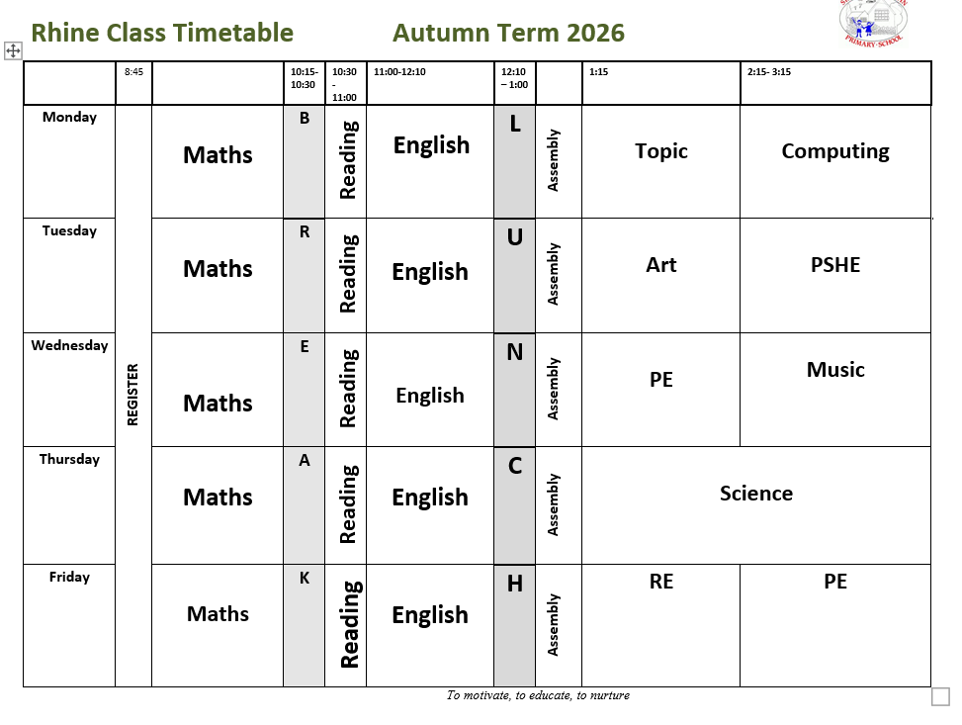
Weekly Timetable (example)

Slide 5
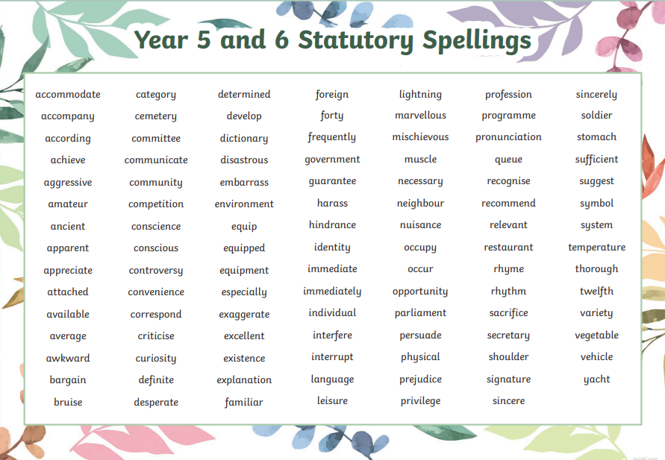
Home Learning
1. Reading comprehension – Due on Thursdays
2. Maths – CGP book – Due on Mondays
3. Spelling – practice of statutory lists on Spelling shed – children will already have a log in
Tested termly
Year 6 – weekly SPAG – due Monday

Slide 6

Reading Expectations
Colour banded or free-reader book
- Re-reading for fluency if decoding
- 5 times per week
- Record on reading bookmark
- Book changing at school
- Continue to read with and to your child
Class Reading Journal that a child takes each week to do a review and share with the class

Slide 7
Medication
If your child needs any medicines during the school day , we need signed permission this can be done with a form via the office.
If your child uses an inhaler then we need an up to date plan and permission.
Please be aware that we are a nut aware school

Slide 8
What does my child need each day?
- Reading book and bookmark
- Water bottle
- Coat and other outdoor clothing (named please!)
- On time (08:40am line up in the mornings)
PE DAYS – WEDNESDAY & FRIDAY

Slide 9
Statutory Assessments
Year 6 – End of Key Stage 2 Assessments
Maths
English – SPAG and Reading papers
Writing – Teacher Assessment
Monday 10th May – Thursday 14th May 2027

Slide 10
Trips and Events
While we do not offer overnight residential stays, we organise a variety of engaging, curriculum linked day trips throughout the year. These off-site visits are designed to enrich classroom learning and provide hands-on, real-world experiences across a wide range of subjects including wider life skills.

Slide 11
Secondary School
Year 6 parents need to apply for a secondary school place through Wiltshire Council
GOV.UK: School admissions(opens new window)
Deadline 31st October 2026

Slide 12

Communication
Should you have any questions or queries, please visit or email the office on
admin@stanton-st-quintin.wilts.sch.uk
This address should also be used for reporting absences (this should be done by 9:30am or we will contact you).
Please also notify us if your guide is being collected by someone else.

Slide 13
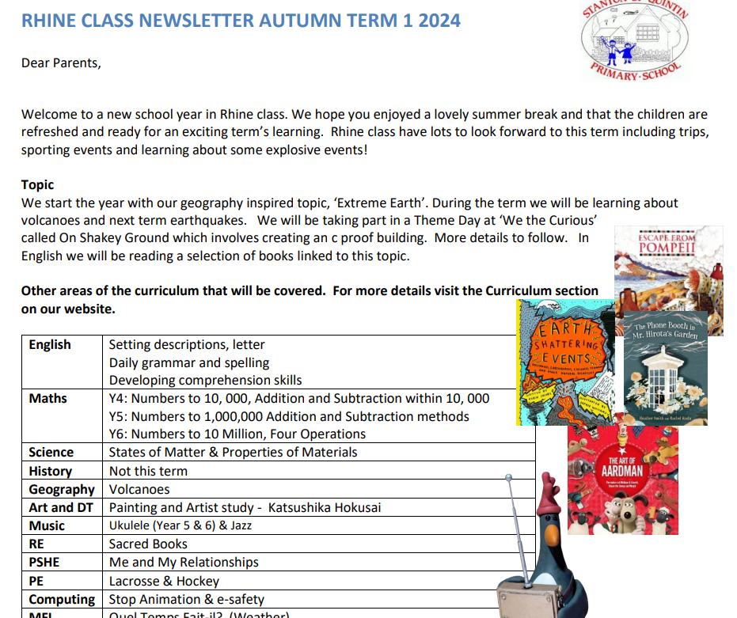
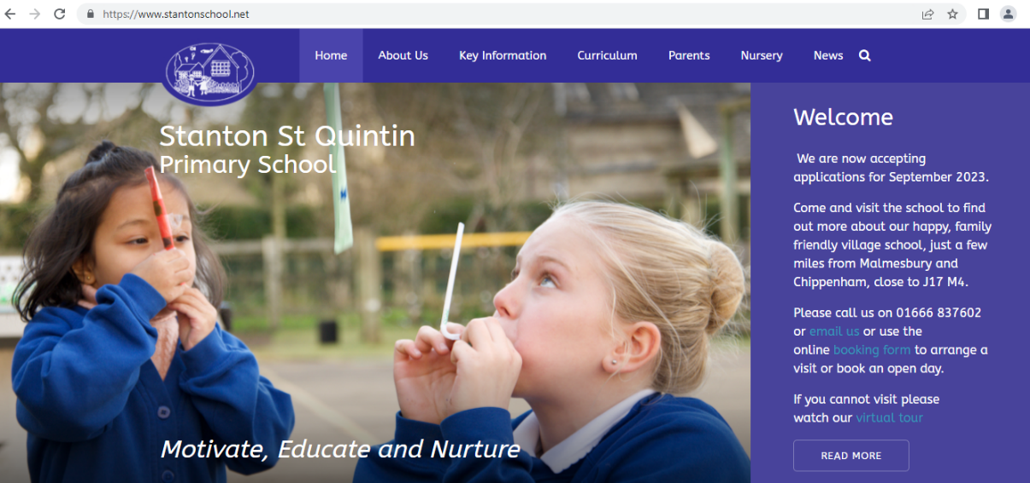
Class newsletter
School website

Slide 14
Any questions

