Slide 1
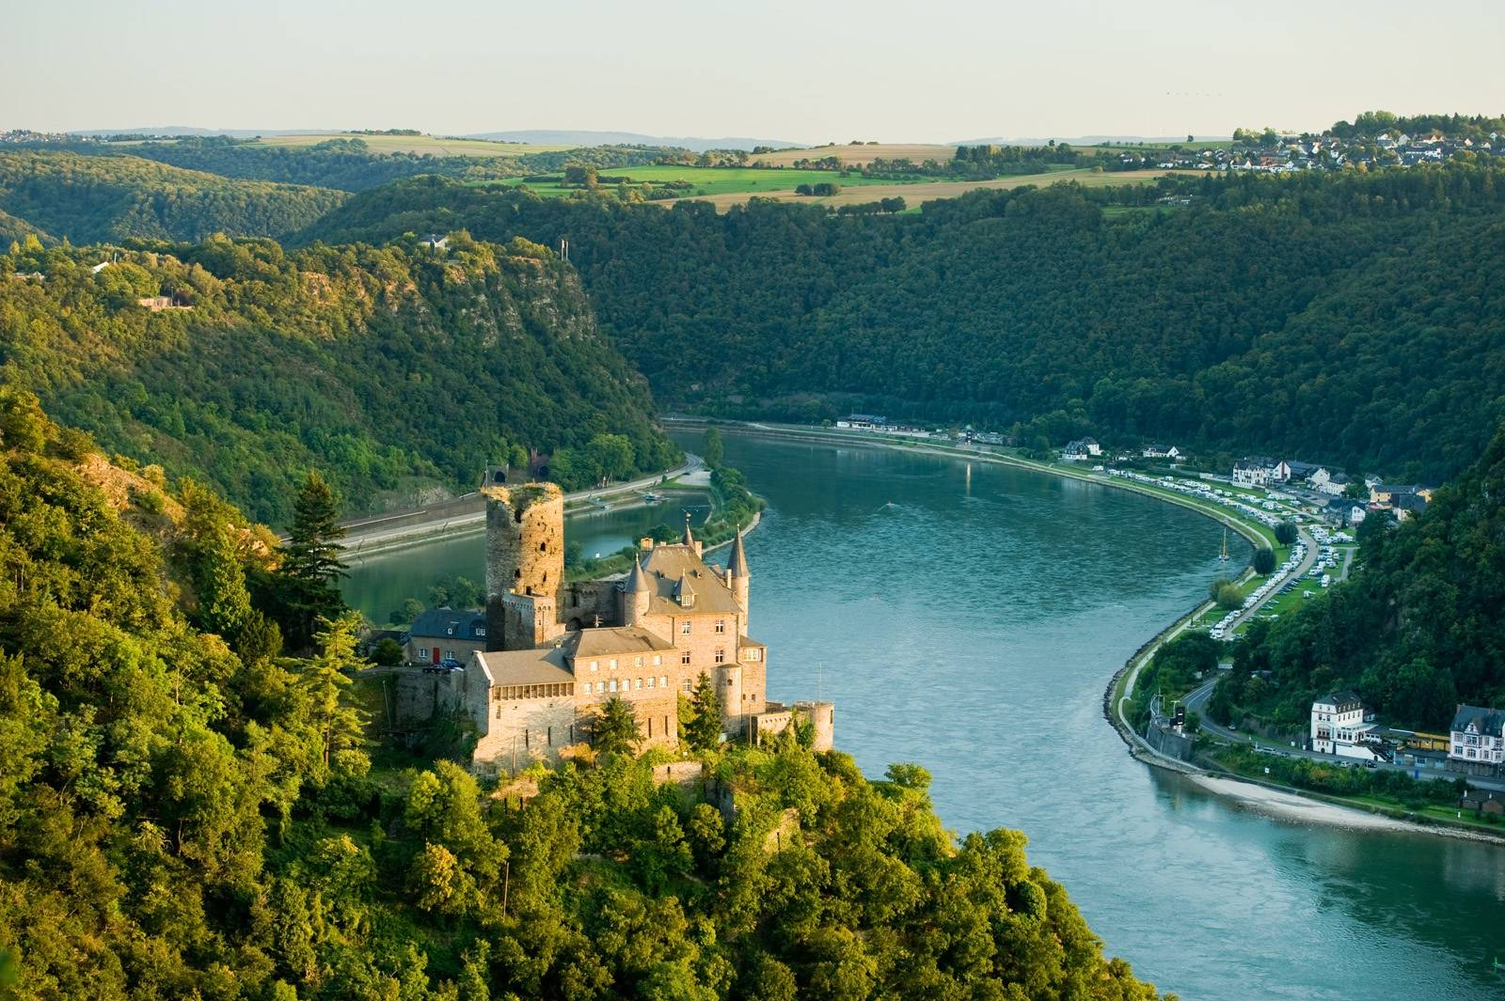


Welcome to Rhine Class
2025-2026
Year 4, 5 and 6

Slide 2

Communication
Should you have any questions or queries, please visit or email the office on
admin@stanton-st-quintin.wilts.sch.uk
This address should also be used for reporting absences (this should be done by 9:30am or we will contact you).
Please also notify us if your guide is being collected by someone else.
Parents Evenings
Tues 7th and Thurs 9th Oct

Slide 3
Rhine Team
Class teacher: Mrs Matthews
Cover Supervisors: Mrs MacKenzie
Miss Hyde
Specialist Teachers:
Mr Dunn – Music
Mr Roberts – Lacrosse
Mr Myles - Computing

Slide 4
Mixed age class ​
We are one class, and it is our aim to achieve cohesion as a class whilst recognising the different year groups.
Experienced at meeting the year group and individual needs within a mixed age class.
Different year group objectives are taught in line with the National Curriculum. At times this will be as individual year groups within the class,or taught as a whole class with differentiated activities/outcomes.

Slide 5
Topics
Autumn
Go with the Flow (Geo)
Crime & Punishment (History)
Spring
Tomb Raiders (History)
Flight (Geo & History)
Summer
Protect our Planet (Geo & History)
Production

Slide 6
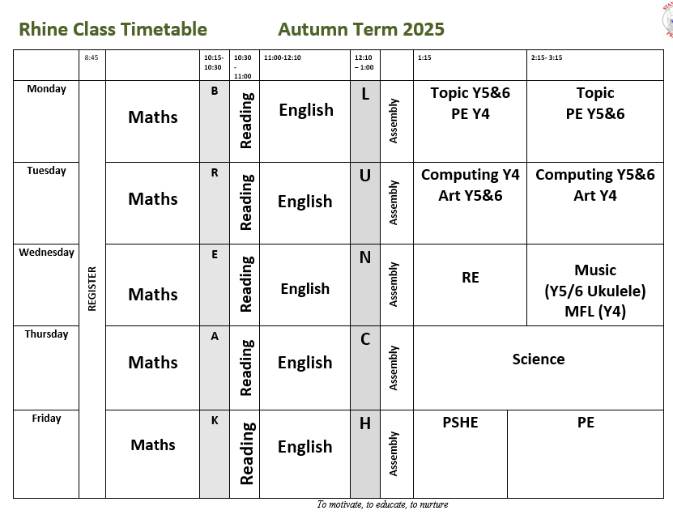
Weekly Timetable

Slide 7

Reading
Reading Pouch: Colour banded or
free-reader’ book
- Re-reading for fluency if decoding
- 5 times per week
- Record on reading bookmark
- Book changing at school
- Continue to read with and to your child

Slide 8
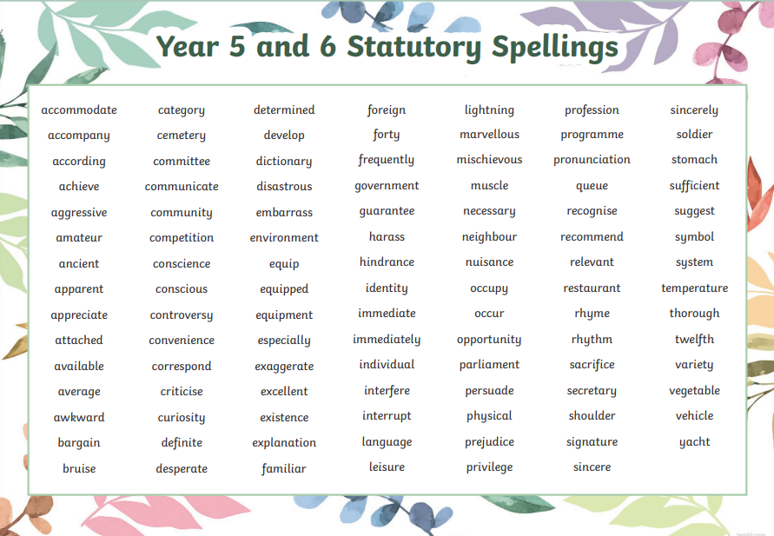

Home Learning
1. Reading comprehension - weekly
2. Maths – weekly 10 mins practice & times tables
Both due in on a Tuesday
3. Spelling – practice of statutory lists
Spelling shed – children will have a log in
Tested termly
Year 6 – weekly SPAG

Slide 9
Medication
If your child needs any medicines during the school day , we need signed permission this can be done with a form via the office.
If your child uses an inhaler then we need an up to date plan and permission.
Please be aware that we are a nut aware school as we have a child with a severe nut allergy

Slide 10
What does my child need?
- Reading pouch – with book and bookmark
- Water bottle
- Coat and other outdoor clothing (named please!)
- Hair tied up
- On time (08:40am line up in the mornings)
PE DAYS – MONDAY & FRIDAY

Slide 11
Statutory Assessments
Year 4 – Multiplication Times Table Check
Year 6 – End of Key Stage 2 Assessments
Maths
English – SPAG and Reading papers
Writing – Teacher Assessment

Slide 12
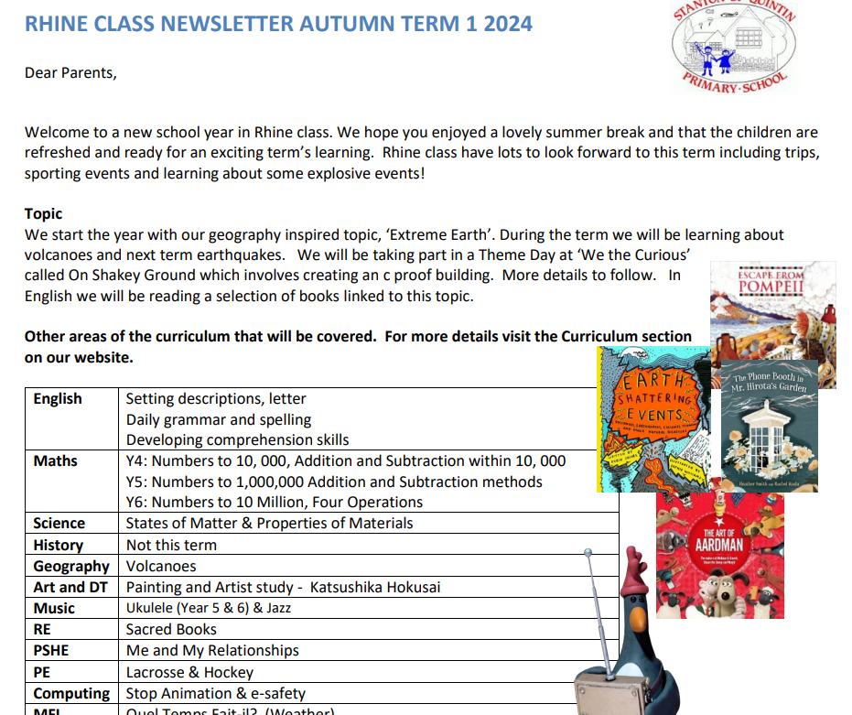
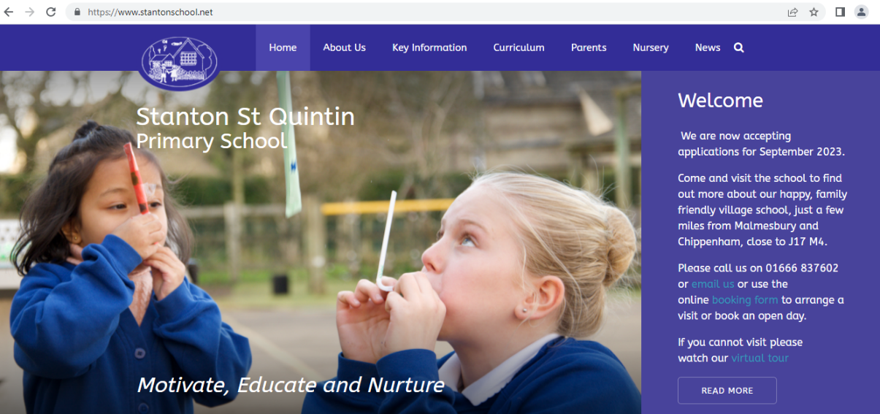
Class newsletter
School website

Slide 13
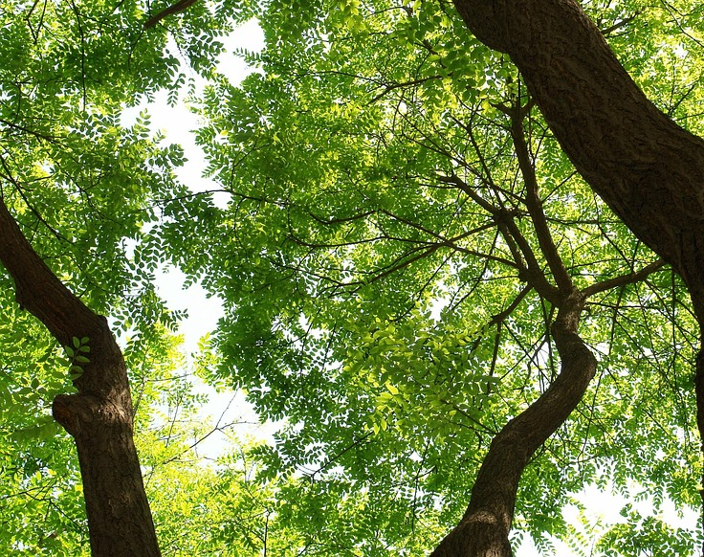
Outdoor Learning
Not all classrooms have four walls
The benefits of learning outdoors are well-documented. As well as giving children space and freedom, and a change from the classroom, learning outdoors actively involves and engages children in a multi-sensory environment.
Our aim is to to deliver planned, quality outdoor learning experiences that enhance the teaching and learning of the curriculum.

Slide 14


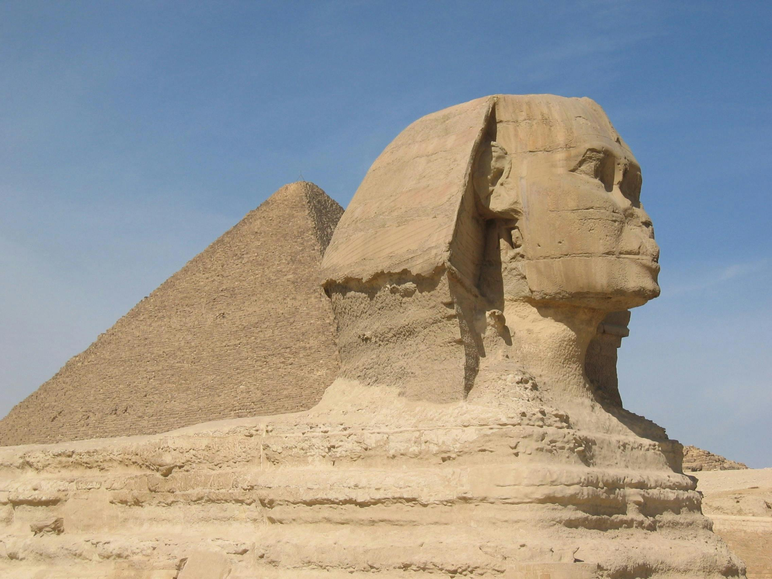
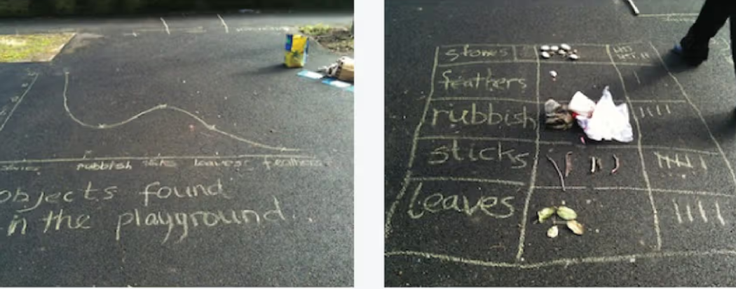
What might this look like?
In RE, learning about the Sikh Naming Ceremony, the children might re-enact the ceremony outdoors and using natural artefacts to design a name plate.
Learning about the Egyptians, the children might use drainpipes and outdoor equipment to create a model of the Nile River, including what is on the land adjacent to the river and the tributaries. Or they might use the hieroglyphic alphabet to write clues and create a scavenger hunt.
Data collection and graph drawing: collecting continuous data from outside and then children the freedom to experiment and draw graphs large on the playground, it helps to build confidence in constructing their own line graphs, deciding on an appropriate scale to use and using labels

Slide 15
Any questions

