Slide 1

INSPIRING and supporting your child as a reader
Led by Mrs Verity Anderson
English Subject Lead
at Stanton St Quintin Primary School and Nursery
Welcome to this evening’s workshop and thank you for attending.

Slide 2

Why is learning to read so important?
Creating a love of reading in children is potentially one of the most powerful ways of improving academic standards in school.
There can be few better ways to improve pupils chances in school, or beyond in the wider world than to enable them to become truly independent readers.
Notes:
Creating a love of reading in children is potentially one of the most powerful ways of improving academic standards in school.
There are few better ways to improve pupils chances in school, or beyond in the wider world than to enable them to become truly independent readers and to love reading.
At Stanton we truly believe that reading gives our children power. Reading unpins the entire curriculum and therefore if they can read, they have the power to learn. Even better still, if they enjoy reading, their life choices will greatly open up to them.
That is why we place such emphasis on learning to read but also on creating a reading for pleasure culture here at Stanton, with an aim to instil a love of reading in every child.

Slide 3
The importance of talk
Children from ‘talk a lot’ families have heard 33 million words by the age of 3 and will have had 1700 hours of stories.
Children from ‘not talk a lot’ families have only heard 9 million words by the age of 3 and will have only had 25 hours of stories.
Notes:
Starting a child on their reading journey, stems right back to a very early age. It stems back to learning to talk.
I wanted to share some statistics with you about the importance of talk.
Children from ‘talk a lot’ families will have heard 33 million words by the time they reach the age of 3 and will have likely had 1700 hours of stories.
Children from ‘not talk a lot’ families have only heard 9 million words by the age of 3 and will have only had 25 hours of stories.
Even before starting school, there can be an impact on a child’s outcomes, based on how much we talk to our children and by the number of stories we share with them.
I shall be running a workshop at a later date about the value of talk and how we can create a vast number of opportunities for talk with our children, so look out for that.

Slide 4
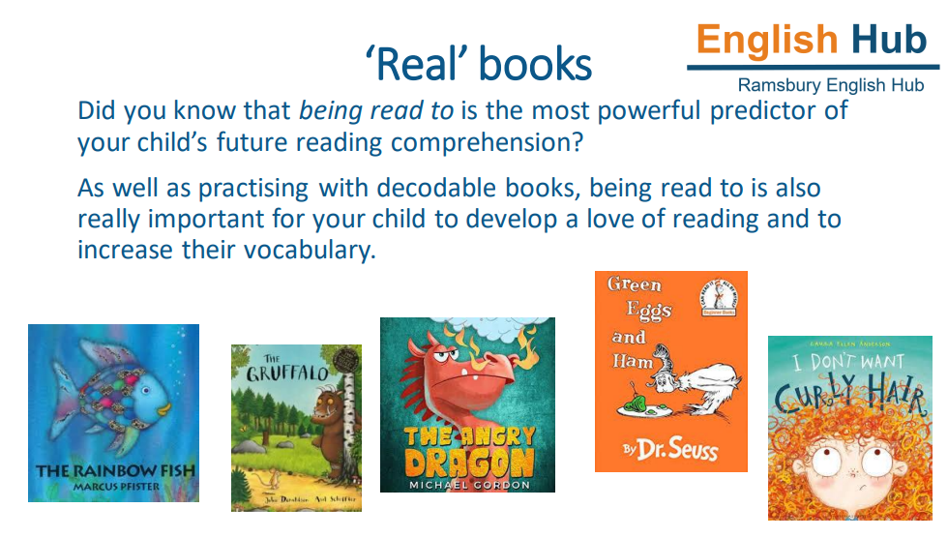

Slide 5
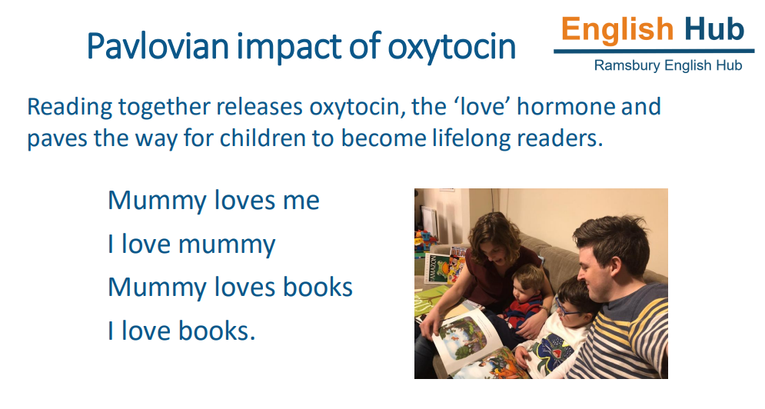

Slide 6
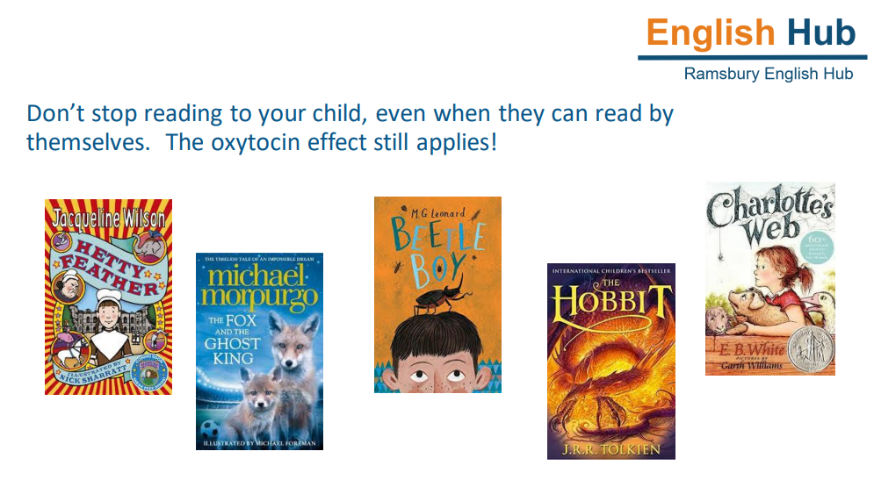

Slide 7
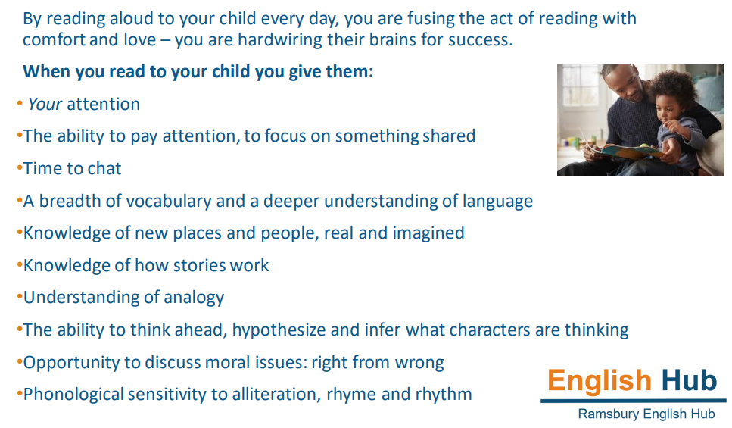

Slide 8

Clear Pronunciation
- Insisting upon clear pronunciation when reading and speaking – modelling clear speech sounds
- Avoiding lazy speech which is proven to have a negative impact on decoding to read and also segmenting to spell
Notes:
Clear pronunciation when reading and speaking is extremely important. We need to be modelling clear speech sounds to children when they are learning to read, which includes lots of emphasised mouth movements which children practise daily during phonics lessons at school.
For our older children, it is also ensuring that we are insisting upon clear pronunciation of words when children become fluent readers too.
To give you some examples: we are hearing du instead of the, vey instead of they, wif instead of with, fink instead of think, dere instead of there, member instead of remember, diffent, instead of different, culful instead of colourful.
It is our aim to avoid what we call lazy speech which is proven to have a negative impact on decoding to read and also segmenting to spell and if a child has an identified speech and language need, supporting heir speech development in a targeted way.

Slide 9
Teaching early reading
44 sounds in the English language
Sounds Write Phonics Scheme
Reception: Initial Code- children start by learning the individual sounds
Key Stage 1: Extended Code- children learn all the remaining common vowel and consonant sound to spelling correspondences until all the common spellings for the forty-four sounds in English have been covered.
Notes:
There are 44 sounds to learn in the English language.
When starting school, we teach children to read using a phonetic approach. Here at Stanton we use the Sounds Write Phonics Scheme to teach reading and writing.
Initial
Extended
Look at what this means in more detail

Slide 10
Reception
Unit 1: a, i, m, s, t
Unit 2: n, o, p
Unit 3: b, c, g, h
Unit 4: d, f, v, e
Unit 5: k, l, r, u
Unit 6: j, w, z
Unit 7: x, y, ff, ll, ss
Unit 8: VCC and CVCC
Unit 9: CCVC
Unit 10: CCVCC, CCCVC, CCVCCC
Unit 11: sh/th/ch/tch/ck, ng
two letters, one sound
three letters, one sound
Sounds Write, Initial Code
Children learn the individual sounds.
Notes:
In Reception, children learn the initial code- starting with learning the individual sounds in Unit 1-7, building up to ff/ll/ss/sh/th/ch/ck/ng by the end of Reception. We call these ‘two-letters, one sound’ with tch being ‘three letters, one sound’.
Video- let’s see how these sounds should be correctly pronounced.
Please note the real emphasis on accurate pronunciation of sounds when reading or spelling with your child.
It is crucial that we do not add an uh sound on to the end of words.
Let’s practise a few now!

Slide 11
s s

Slide 12
t t

Slide 13
p p

Slide 14
n n

Slide 15
l l

Slide 16
c c

Slide 17
m m

Slide 18
v v

Slide 19
b b

Slide 20
f f

Slide 21
f th

Slide 22
Reception
Unit 1: a, i, m, s, t
Unit 2: n, o, p
Unit 3: b, c, g, h
Unit 4: d, f, v, e
Unit 5: k, l, r, u
Unit 6: j, w, z
Unit 7: x, y, ff, ll, ss
Unit 8: VCC and CVCC
Unit 9: CCVC
Unit 10: CCVCC, CCCVC, CCVCCC
Unit 11: sh/th/ch/tch/ck/ng
Sounds Write, Initial Code
Children learn the individual sounds.

Slide 23
V = vowel c = consonant
CVC = cat, hat, mat
VCC = ant, ask, end
CVCC = tent, sent, sand
CCVCC = stamp, frost, plant
split, strap
CCCVC =

Slide 24
Key stage 1
(extended support in Key Stage 2)
Same sound, different spelling
ay – play
ea – great
ai – rain
a-e – made (split spelling)
Same spelling, different sound
ea
ea – great
ea – seat
ea – bread
Sound Write, Extended Code
Made up of 49 units.
Notes:
From Year 1 onwards, children progress to the extended code. They learn all the remaining common vowel and consonant sound to spelling correspondences until all the common spellings for the forty-four sounds in English have been covered.
We learn ‘same sound, different spelling’ for example…
And we learn ‘same spelling, different sound’ for example…
In parallel with this, pupils are taught how to read and spell polysyllabic words, progressing from two-syllable to five and six-syllable words.
VIDEO

Slide 25
break

Slide 26
night

Slide 27
corner

Slide 28
turning

Slide 29
rained

Slide 30
favour

Slide 31
listen

Slide 32
taste

Slide 33
tasty

Slide 34
remember
Notes:
Clear speech is vital with longer polysyllabic sounds. As children’s vocabulary grows, if we are not insisting upon clear pronunciation, we begin to see an impact on segmenting to spell and lots of missing sounds.

Slide 35
presentation

Slide 36
escalate

Slide 37
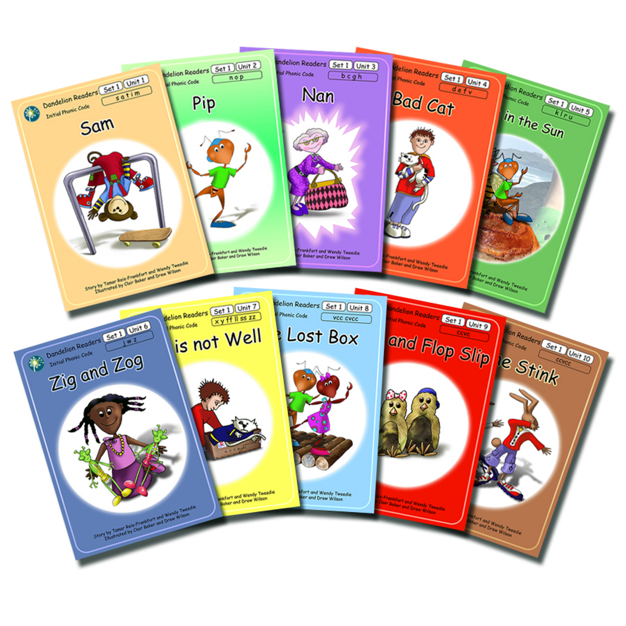
Using phonics to read
If a child is struggling when reading;
1. “Have a go at saying the sounds and reading the word.”
“Can you see any _____ letters, one sound in this word?”
2. If they continue to struggle, point out the sound-
“This is two letters, one sound, ai. Can you have a go at saying the
sounds and reading the word now?”
3. If the child continues to struggle after several attempts-
“This word is p ai n t, paint. Now you try.” pointing to the sounds as you model.
4. Finish with lots of praise!
Notes:
Providing children with phonetically decodable books is very important when they are learning to read. This provides children with the opportunities to apply the sounds they have been learning and to achieve when reading.
When children are reading, we are encouraging them to spot those ‘two letters, one sound’, ‘three letters, one sound’ etc in words.
SLIDE
This technique applies to all children learning to read, regardless of age.

Slide 38
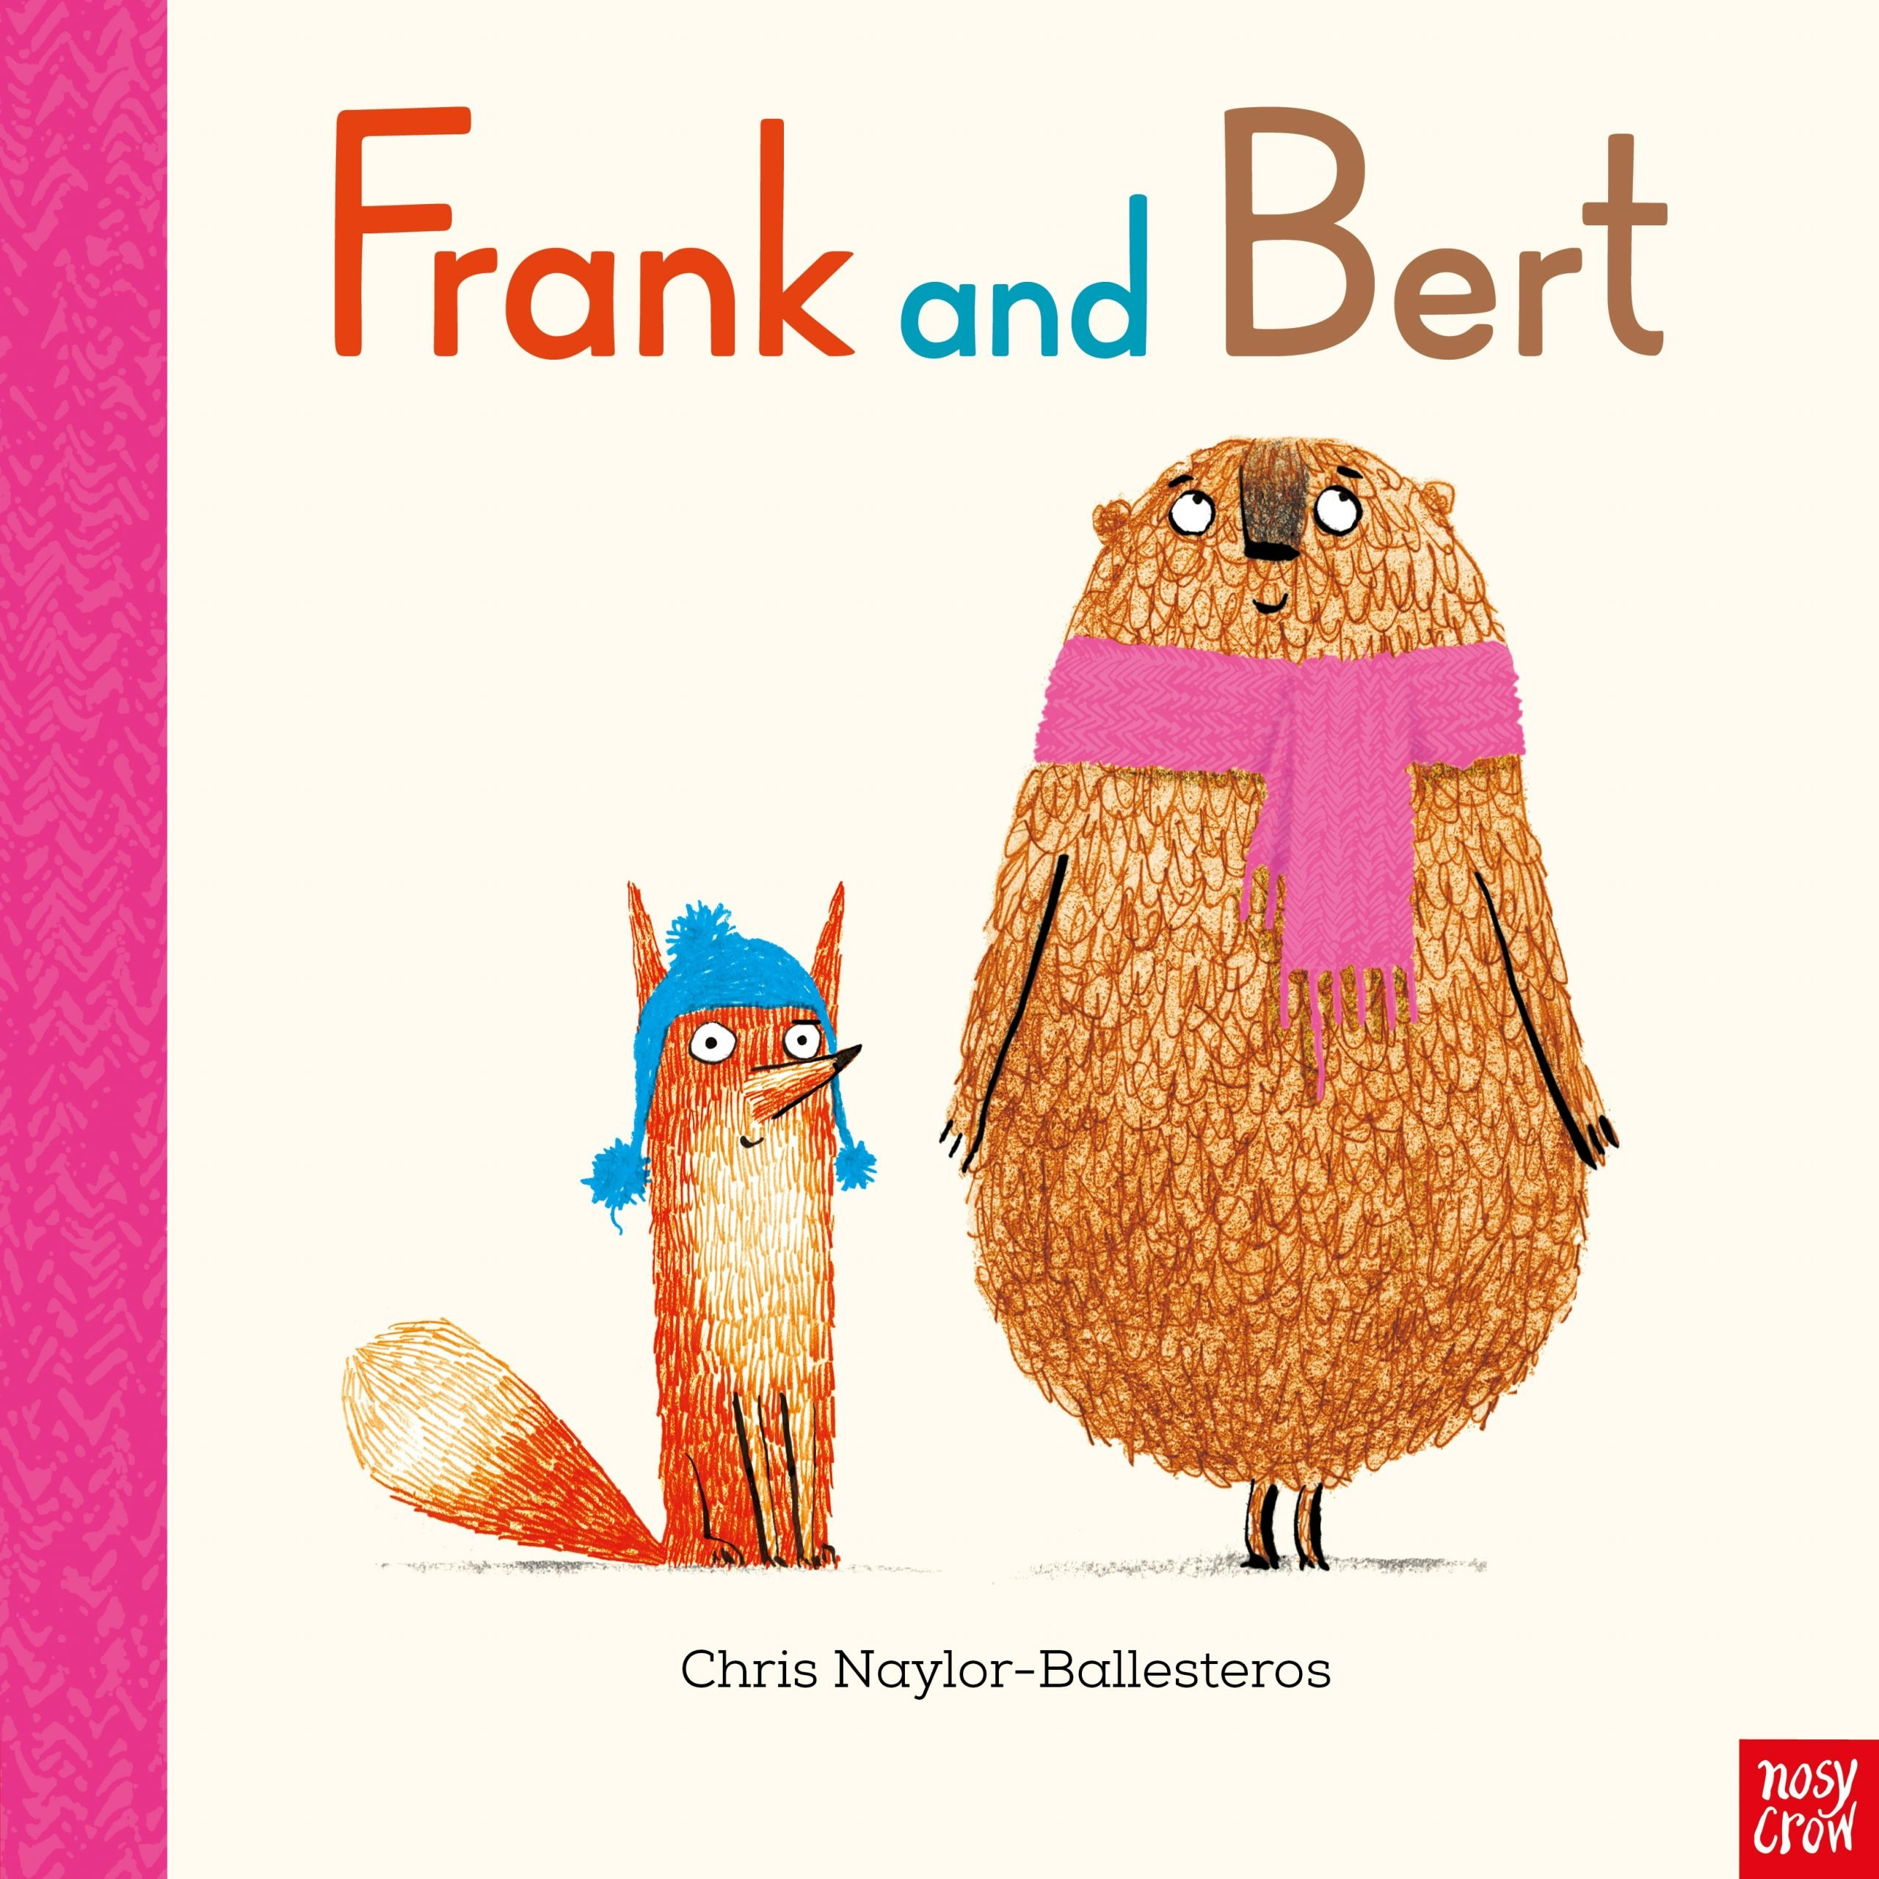
Re-reading for fluency
Why do we ask children to read the same book more than once when they are learning to read?
- Fluency
- Confidence
- Enjoyment
What if my child is a fluent reader and they wish to read the same book again? Should I encourage them to?

Slide 39


My child does not want to read
- Avoid reading becoming a chore or a punishment
- Be positive
- Allow children to see you reading
- Share the reading with them
- Praise and enthusiasm
- Celebrating
- If a child is too tired, read to them instead. Although we would like children to be reading to an adult every day at home for at least 10 minutes, there quoll be times when they are just too tired and that is okay
- Take children to book shops!
Notes:
AVOID READING BECOMING A CHORE OR A PUNISHMENT. We want to instil a love of reading in chn but this can be hard if they are struggling to engage with reading.
- Be positive about reading yourself
- Allow children to see you reading
- Share the reading with them, whether they be an early or advanced reader
- Lots of praise and enthusiasm when they read
- Let them hear you celebrating and telling other family members about what they read to you, how they are improving etc.
- If a child is too tired, read to them instead. Although we would like children to be reading to an adult every day at home for at least 10 minutes, there quoll be times when they are just too tired and that is okay
TAKE CHILDREN TO BOOK SHOPS!

Slide 40
Word reading vs comprehension- the two strands of reading
- Develop a range of comprehension skills
- Allow children to read and not be quizzed!
- Open Book Talk
“In my opinion, I think Harry did what he needed to do to save his friends but he did act a little irresponsibly. What do you think?”
“I was really shocked by what happened to Little Red! What did you think?”
“My favourite part was when Mrs Jones jumped out of the cupboard because I didn’t know she was in there! What was your favourite part?”
Notes:
As part of the National Curriculum, children are expected to develop a range of comprehension skills as they progress through primary school and this is something that requires assessment in line with the curriculum.
However, it is so important that we simply allow children to read. We do not want children to feel quizzed or to take away from the pleasure of reading.
When reading with a child at home, checking their understanding of what they have read is important and book talk can be incredibly powerful too.
And what we call ‘book talk’ is what I recommend- having a two way discussion about what they think of characters or events in the story will be enough to gage whether they have understood, as opposed to testing them.

Slide 41

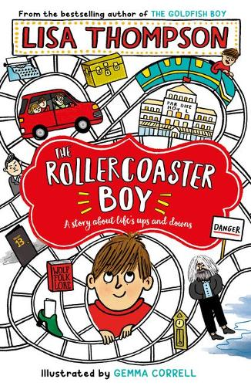
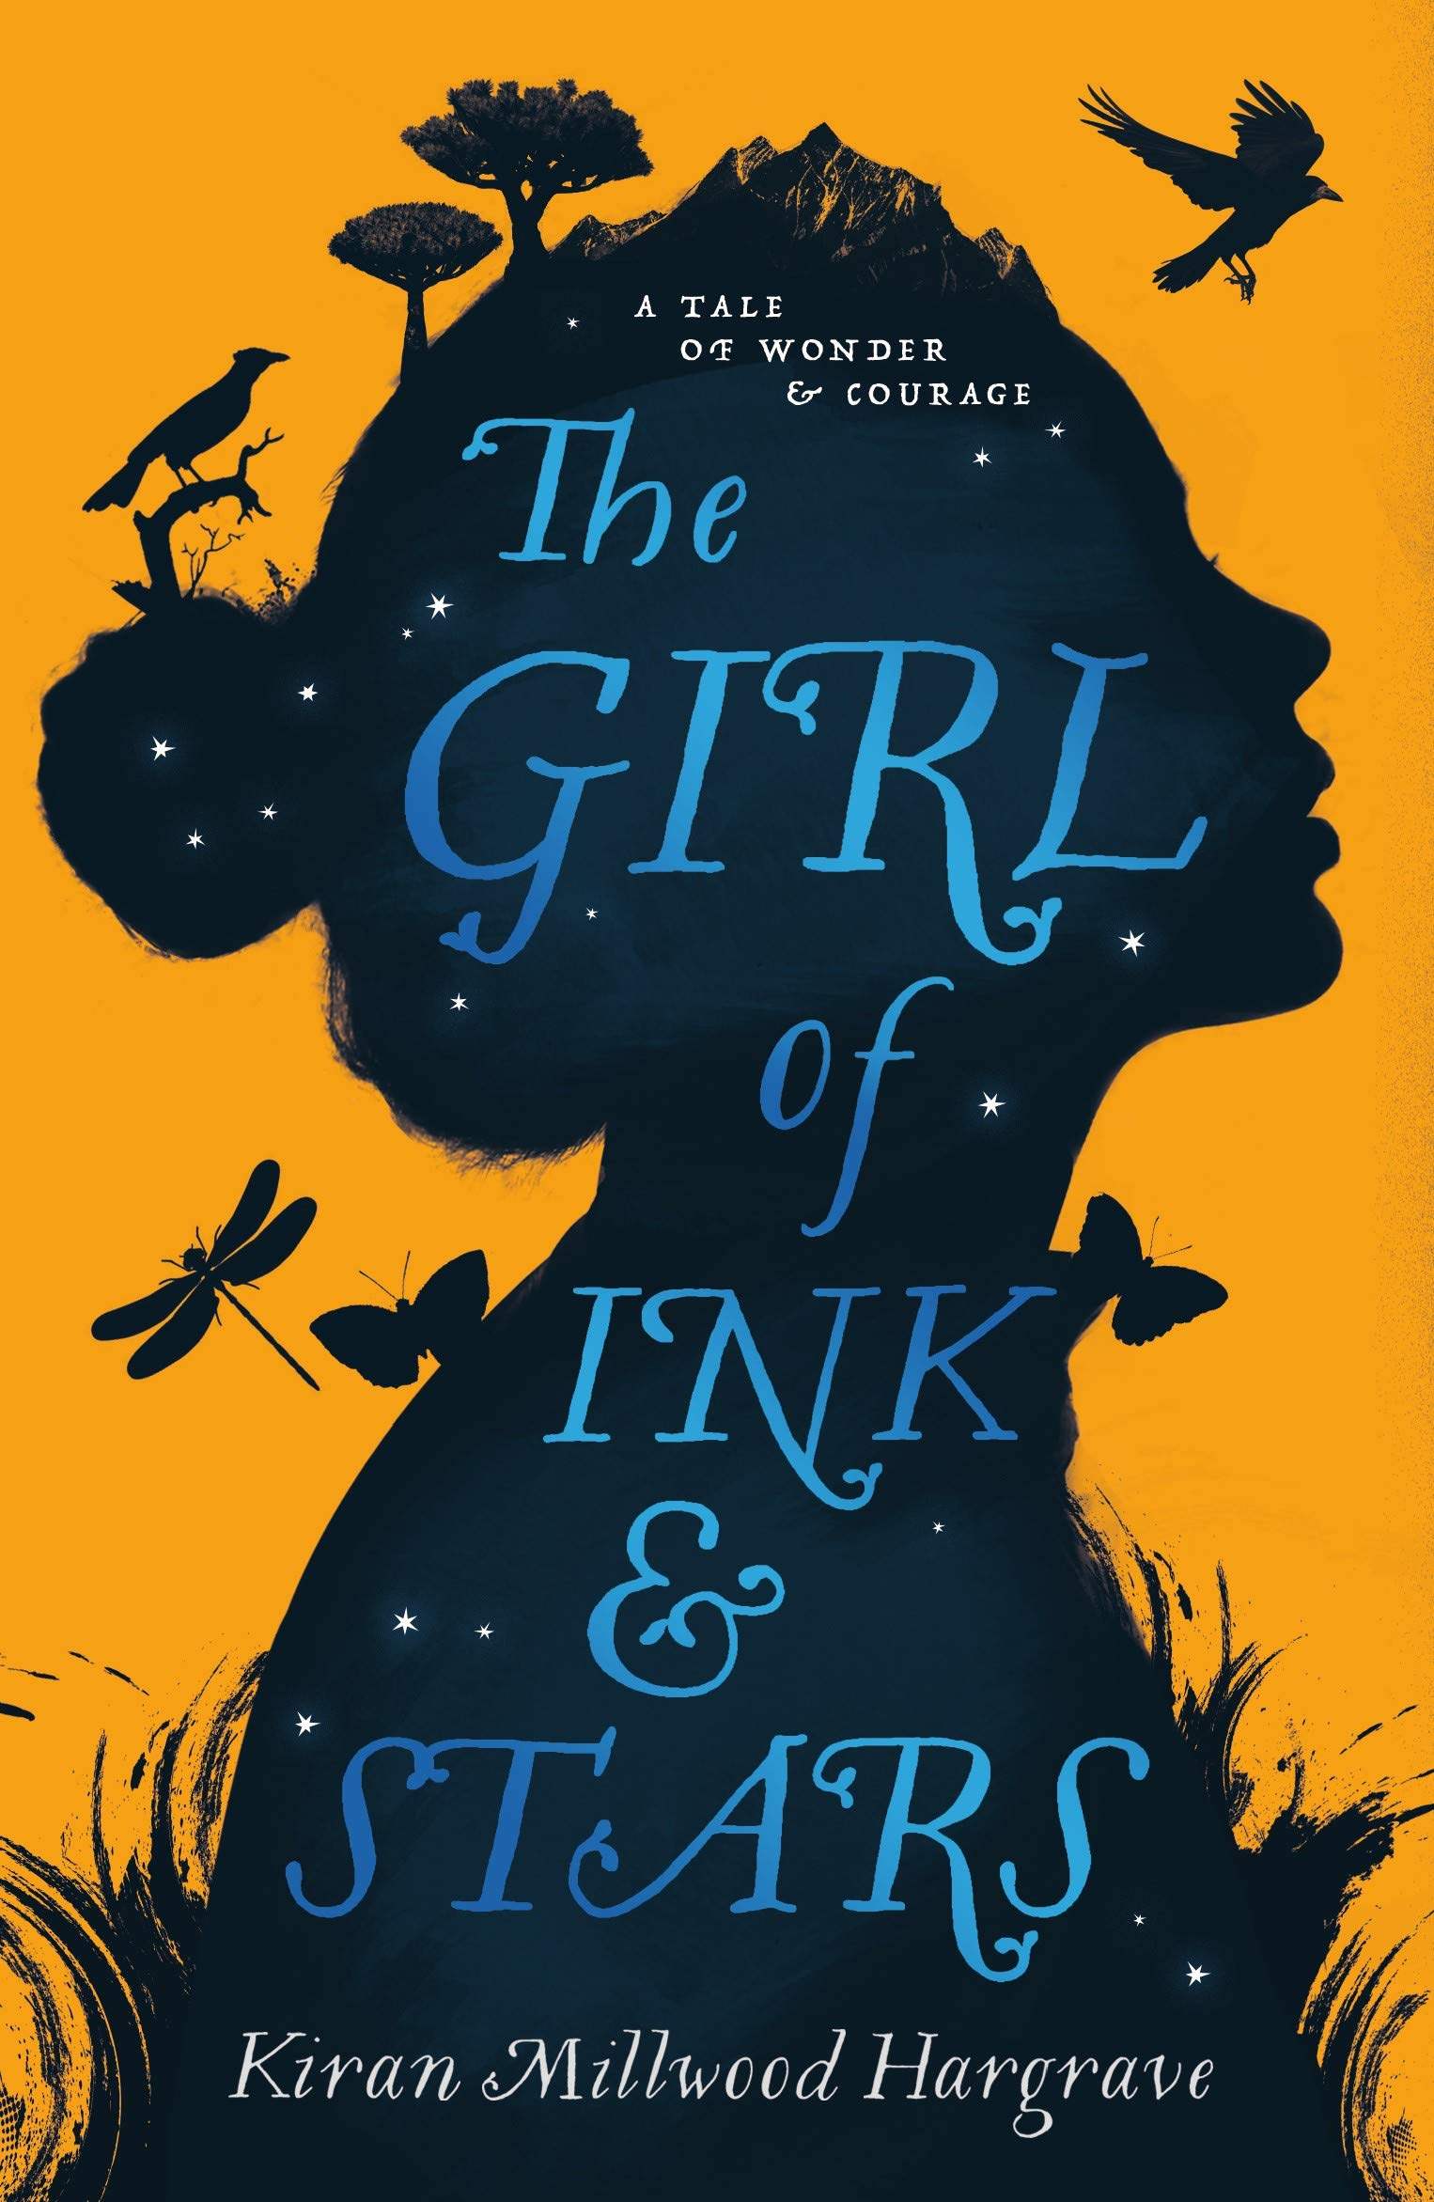
Developing vocabulary
- Exploring new words and discussing meaning
- We want to create a culture of asking if children do not understand the meaning of a word, in turn building their own vocabulary banks for speech and writing.
- Create a bank of vocabulary from reading- could use reading journals for this or make their own word collectors maps.

Slide 42
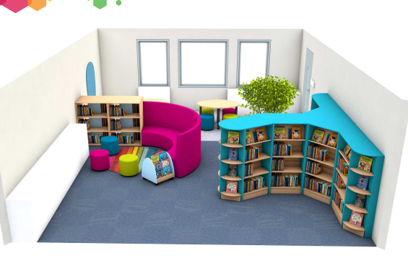
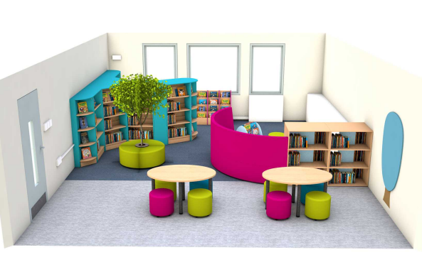
What’s happening at Stanton?
- Wiltshire Year of Reading
- New Library
- New books
- Stanton Reading Spine
- Reading at the core of what we teach
- Book Talk!

Slide 43


Slide 44
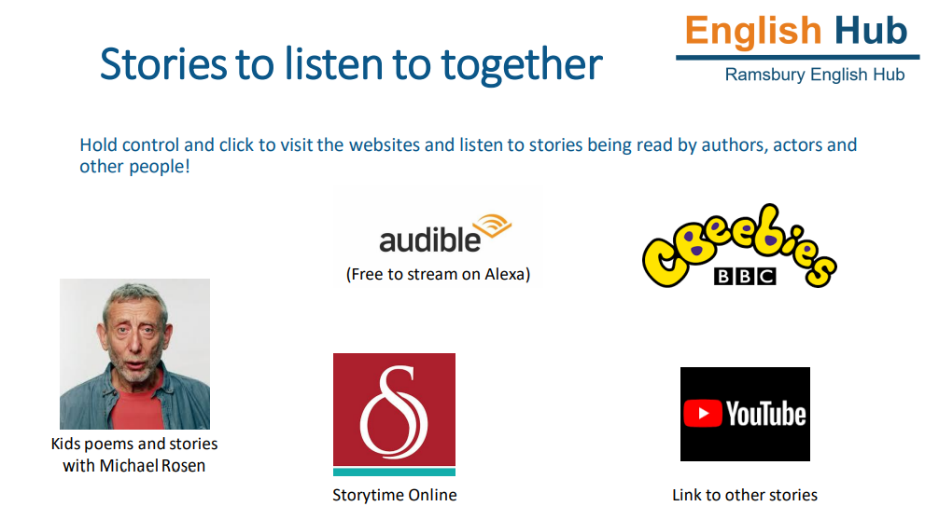

Slide 45
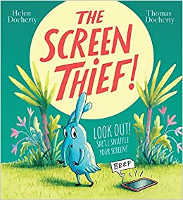
The children have enjoyed a wealth of stories today so I thought it only fair to share a story with you this evening.

Slide 46

https://m.youtube.com/watch?v=09bIi_Mf1KE

Slide 47

Thank you for listening and working as a partnership with us to support your child to become a lifelong reader.
I welcome any questions.

